Slide 1
Java Programming:
From the Ground Up
Lecture 15
Chapter 15 – Part 1
Stream I/O and Random Access Files

Slide 2
Objectives
Understand the Byte Stream and Character Stream classes
Understand console I/O using the Byte stream and Character Stream classes
Understand text file I/O using the Byte stream and Character Stream classes
Understand the connections between the Byte Stream hierarchy and the Character Stream hierarchy

Slide 3
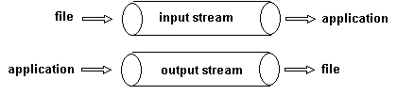
The Stream Classes
A stream is an abstraction of the flow of data.
An input stream constitutes the flow of data to an application, and an output stream represents the flow of data from an application.
A stream is a flow of data

Slide 4
The Byte Stream and the Character Stream Classes
Java’s stream classes encapsulate all input and output.
Java stores all data, even the most complex object, as a sequence of bytes.
All objects are built from bytes.
Bytes flow to and from an application via streams.
Java provides the Byte Stream classes for byte I/O.
The Byte Stream classes are the foundation of all Java I/O.
The Byte Stream classes can be used independently, or as helpers for another hierarchy of I/O classes called the Character Stream classes.
Character I/O is usually accomplished with the Character Stream classes.

Slide 5
The Byte Stream and the Character Stream Classes
Using the Character Stream classes you can process data independent of a particular character code.
These classes automatically and invisibly handle ASCII, Unicode or any other character code.
The Character Stream classes are clients of the Byte Stream classes, and are thereby dependent on them.
The Byte Stream classes and the Character Stream classes have a similar structure.
Each collection of stream classes is split into a pair of hierarchies, one for input and one for output.
For the Byte Stream collection, the root classes of these two hierarchies are InputStream and OutputStream, respectively.
The Reader and Writer classes fill this role for the Character Stream classes.
These classes reside in the java.io package.

Slide 6
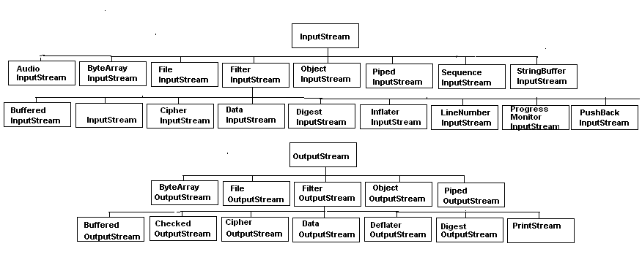
The Byte Stream and the Character Stream Classes
The InputStream and OutputStream hierarchies for byte I/O

Slide 7
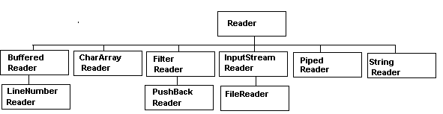
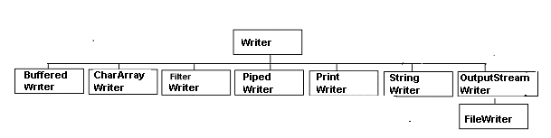
The Byte Stream and the Character Stream Classes
The Reader and Writer classes for character I/O

Slide 8
Console Input via the Byte Stream Classes
All console input is accomplished using System.in.
System is a Java class; and like any class, System has attributes or fields.
One field of the System class is declared as
  public static final InputStream in;
This declaration states that the reference, in, refers to an InputStream object.
InputStream, a member of the Byte Stream classes, is abstract.
In fact, in is an instance of the concrete class, BufferedInputStream, which extends InputStream.
Because in is static, in can be accessed as System.in, that is, via the class name.

Slide 9
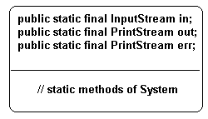
Console Input via the Byte Stream Classes
The fields of System. All are static.

Slide 10
Console Input via the Byte Stream Classes
The BufferedInputStream class offers the capability to handle I/O efficiently.
A buffer is primary memory used to temporarily store data.
Using a buffer increases the efficiency and speed of I/O.
With a buffer, data is moved in large blocks (many bytes in each block) between slower devices (like disks) and the faster buffer.
A program can retrieve individual bytes more quickly from a buffer.
Both the Byte Stream and Character Stream classes provide subclasses with the capability for buffered I/O.
The relevant classes are BufferedInputStream and BufferedOutputStream for the Byte Stream classes, and BufferedReader and BufferedWriter for the Character Stream classes.

Slide 11
Console Input via the Byte Stream Classes
in is an instance of BufferedInputStream, which extends InputStream.
Some of the methods declared in InputStream, inherited by BufferedInputStream, and thus available to the object System.in, include:
int read() throws IOException:
returns the next byte in the stream (an int in the range 0..127)
returns –1 at the end of the stream
int read(byte[] b) throws IOException:
reads up to b.length bytes
returns the number of bytes read, or –1 at the end of the stream
void close() throws IOException:
closes the stream

Slide 12
Console Input via the Byte Stream Classes
int available() throws IOException:
returns the number of bytes that can be read (or skipped over) from this input stream without waiting.
If another method tries to read from the input stream, then other methods are blocked temporarily and must wait
long skip(long n) throws IOException:
skips n bytes in the stream before the next read
To use InputStream and its descendents, import the java.io package.

Slide 13
Console Input via the Byte Stream Classes
Problem Statement:
Devise a short application that reads bytes from the console and displays them on the screen.
Use a cast to interpret the bytes as characters.
Java Solution:
Because System.in belongs to InputStream, the application imports java.io.*.
The read() method can throw an IOException, which, must therefore be caught or declared in a throws clause.
System.in.read() returns an integer in the range 0..127, or -1 if the end of the stream is reached.

Slide 14
Console Input via the Byte Stream Classes
import java.io.*;
public class Console
{
public static void main(String[] args) throws IOException
{
int b;
int count = 0;
while (( b= System.in.read()) != -1)
{
count++;
System.out.println(b + " "+(char)b); //print byte and char value
}
System.out.println("Number of Characters: "+count);
}
}

Slide 15
Console Input via the Byte Stream Classes
Output:
On Windows systems, newline is represented by a sequence of two ASCII codes, a carriage return followed by a line feed.
The integer 13 is the ASCII code for carriage return, and 10 represents line feed. The Control-Z (Windows)character signals the end of input.
On a Linux/Unix systems, Control-D signifies the end of input, and newline is represented by the ASCII value 10 alone.
Indeed, the modern style refers to ASCII code 10 as newline rather than line feed.
Output on these systems shows 10 after each sequence of letters and codes, but not 13.

Slide 16
Console Input via the Byte Stream Classes
abc
97 a
98 b
99 c
13
10
b
98 b
13
10
hello
104 h
101 e
108 l
108 l
111 o
13
10
^z
Number of Characters: 15
The first three values given to the program are the characters a, b, and c, with character codes 97, 98, and 99 respectively, followed by newline represented by character codes 13 and 10.
The next input value is the single character b followed again by newline.
Finally, the characters h, e, l, l, o, newline, and Control-z are entered.
The program displays the ASCII codes for each letter as well as 13 and 10, the codes for carriage return and line feed that together represent the newline character.

Slide 17
Console Input via the Character Stream Classes
A call to read() via a Character Stream object returns a Unicode character code (two bytes).
Character Stream classes are smart enough to invisibly adapt to an eight-bit scheme.
The Character classes are robust enough to handle thousands of different characters from Latin, to Hebrew, to Chinese, but still smart enough to know when the local operating system uses eight bits with just 128 (or 256) possible characters.

Slide 18
Console Input via the Character Stream Classes
The BufferedReader class (in the Character Stream classes) is used to accomplish efficient character input via the methods:
int read() throws IOException:
reads a single character and returns its code number, and
String readLine() throws IOException:
reads a line of text and returns the line as a String.
The convenient readLine() method of the BufferedReader class has no counterpart in BufferedInputStream.
The class constructor is BufferedReader(Reader in).

Slide 19

Console Input via the Character Stream Classes
Character Stream classes do not work independently of the Byte Stream classes.

Slide 20
Console Input via the Character Stream Classes
A BufferedReader object uses System.in, an object from the Byte Stream hierarchy, to accomplish console input.
System.in is not a Reader object belonging to a Character Stream class but an InputStream object.
BufferedReader needs System.in but System.in cannot be passed directly to BufferedReader.
System.in belongs to the wrong hierarchy.
Java provides a link or bridge between the Character Stream classes and the Byte Stream classes.
This bridge is InputStreamReader.
An object belonging to InputStreamReader (a Character Stream class) reads bytes and converts those bytes to characters.

Slide 21
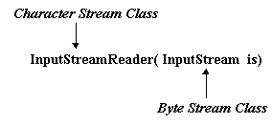
Console Input via the Character Stream Classes
One of the constructors for an InputStreamReader has the form:
The Character Stream and Byte Stream classes are linked via InputStreamReader.
Character input is accomplished with a BufferedReader object as:
  InputStreamReader link = new InputStreamReader(System.in); // link is a Reader object
  BufferedReader br = new BufferedReader( link); // wrap a Reader with BufferedReader
Or
  BufferedReader br = new BufferedReader (new InputStreamReader (System.in));

Slide 22
Console Input via the Character Stream Classes
Thw InputStreamReader, link, wraps System.in, and the BufferedReader, br, wraps link.
Wrapping an object means that the functionality of the wrapped object is accessed via the wrapper.
The BufferedReader class supplies a read() method that reads one character, as well as a readLine() method that reads an entire line of text and returns the line (excluding any new line characters) as a String.

Slide 23
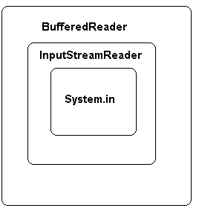
Console Input via the Character Stream Classes
Console input using the BufferedReader class
 | InputStreamReader link = new InputStreamReader(System.in); // link connects the two Stream hierarchies BufferedReader br = new BufferedReader(link); int c = br.read(); // character is returned as an int String str = br.readLine();
System.in is wrapped in an InputStreamReader, which is then wrapped with a BufferedReader

Slide 24
Console Input via the Character Stream Classes
The following method reads characters via a BufferedReader, br.
  public void readCharacterData() throws IOException
  {
  int c;
  int count = 0;
  InputStreamReader link = new InputStreamReader(System.in);
  BufferedReader br = new BufferedReader( link);
  while ( (c = br.read()) != -1)
  {
  count++;
  System.out.println(c + " "+(char)c);
  }
  System.out.println("Number of Characters: "+count);
  }

Slide 25
Console Input via the Character Stream Classes
The following method reads lines of text until the user enters Control-Z signaling the end of input.
  public void readLineData() throws IOException
  {
  String str;
  InputStreamReader link = new InputStreamReader(System.in);
  BufferedReader br = new BufferedReader( link);
  System.out.println("Enter lines of text. End with CTRL-Z");
  while ( (str = br.readLine()) != null)
  // str = br,readLine() returns the value assigned to str
  System.out.println(str);
  }

Slide 26
Console Input via the Character Stream Classes
The assignment:
str = br.readLine(),
returns the value assigned to str.
When the user signals the end of input, br.readLine() returns a null reference and consequently the assignment (str = br.readLine())) evaluates to null.
Such conditions are often used to terminate a loop.

Slide 27
Console Output
Console output can be accomplished using methods of the Byte Stream classes as well as those of the Character Stream classes.

Slide 28
Console Output via Byte Stream Classes
Console output is usually effected with the familiar System.out.print() and System.out.println() methods.
The System class declares a field out:
public static final PrintStream out
System.out refers to an object belonging to the PrintStream class.

Slide 29
Console Output via Byte Stream Classes
The methods print() and println() are defined in the PrintStream class.
Other methods of PrintStream include:
void write(int b) throws IOException:
writes a byte (an integer in the range 0..127) to the output stream
void write(byte[] b) throws IOException:
write up to b.length bytes
void close() throws IOException:
closes the stream
void flush() throws IOException:
flushes the stream; write out any data in remaining in a buffer

Slide 30
Console Output via Character Stream Classes
The Character Stream classes can also be used for character based output, which is important for internationalization.
The PrintWriter class provides an easy mechanism for console output.
Like the byte-oriented PrintStream class, PrintWriter methods include print() and println() methods.
Two of the PrintWriter constructors have the following form:
  PrintWriter(OutputStream os);
  PrintWriter(OutputStream os, boolean flush);

Slide 31
Console Output via Character Stream Classes
The second PrintWriter constructor accepts a boolean argument flush.
When flush is set to true, automatic line flushing is enabled.
This means that the stream is flushed, i.e., all characters are sent to the corresponding output device whenever println() is invoked.
By default, automatic line flushing is not enabled, i.e., a call to println(…) does not automatically print a line of text, but sends it to the stream.
PrintWriter methods do not throw exceptions.

Slide 32
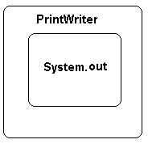
Console Output via Character Stream Classes
Console output using the PrintWriter class
Wrap System.out with a Printwriter | PrintWriter pw =new PrintWriter(System.out); or PrintWriter pw = new PrintWriter(System.out,true) pw.print(s); // s is a String

Slide 33
Files
For our purposes, we define a file as a sequence of bytes and classify a file as either:
  a text file or
  a binary file.
A text file as a sequence of readable characters, that is, a file that you can create and read with a text editor.

Slide 34
Files
An ASCII text file stores each character using eight bits, a 0 followed by a 7-bit ASCII code.
The ASCII character set consists of 128 characters of which 33 are non-printable.
When you open an ASCII text file with a text editor such as Notepad, the program reads the numeric code for each character and displays the corresponding character on the screen.
A Unicode text file encodes each character with two bytes, thus allowing many more possible character codes.

Slide 35
Files
A binary file is any sequence of binary digits.
Each byte in a binary file does not necessarily correspond to a character.
An attempt to read a binary file using a text editor produces some very odd-looking symbols.
Specialized programs such as media players, graphics programs, databases, and even word processors, process binary files.
You might say that text files are readable by humans and binary files are not.
Binary files can save space, and they facilitate specialized formatting specific to the needs of a program.
Binary files are more efficient for both storing and manipulating numeric data.

Slide 36
Files
A File object is instantiated as :
  File name = new File(String filename);
A few methods supplied by the File class are:
public boolean exists():
returns true if the physical file exists; otherwise returns false
public boolean canRead():
returns true if the application can, in fact, read from a file; otherwise returns false
public boolean canWrite():
returns true if an application has permission to write to a file, otherwise returns false

Slide 37
Files
public boolean delete():
attempts to delete a file from the disk and returns true if operation was successful
public long length():
returns the size of the file in bytes
If file access is denied for any reason, each of these methods throws a SecurityException, which is-a RunTimeException and consequently unchecked.

Slide 38
Text File Input via the Byte Stream Classes
The FileInputStream class is a member of the Byte Stream hierarchy that facilitates reading bytes from a text file.
Two important FileInputStream methods are:
int read() throws IOException:
  returns a single byte
close() throws IOException:
  closes the stream
To read from a file, an application must connect a FileInputStream object to a File object, i.e., wrap a File with a FileInputStream.

Slide 39
Text File Input via the Byte Stream Classes
To wrap a File with a FileInputStream, use one of the two constructors:
  FileInputStream(File file);
  or
  FileInputStream(String filename);
Each constructor throws a FileNotFoundException if the file does not exist.
If file access is denied, the constructor throws a SecurityException which is-a RuntimeException and hence unchecked.

Slide 40
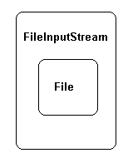
Text File Input via the Byte Stream Classes
FileInputStream for reading bytes from a text file
Wrap a File with FileInputStream | File = file new File("myFile.txt"); FileInputStream in = new FileInputStream(file); or FileInputStream in = new FileInputStream("myFile.txt");. int ch = in.read();. in.close();

Slide 41
Text File Input via the Byte Stream Classes
Problem Statement:
Implement a class ShowFile with a single static utility method that reads characters from a text file, byte by byte, and displays the contents of the file on the screen.
Construct a second class that demonstrates the capability of ShowFile.

Slide 42
Text File Input via the Byte Stream Classes
The ShowFile class
import java.io.*;
public class ShowFile
{
public static void showFile(String filename) throws IOException,
FileNotFoundException
{
int c;
// Create a File object
File input = new File(filename);
// Connect to a stream
FileInputStream in = new FileInputStream(input);
// do the reading
while ( ( c = in.read()) != -1)
System.out.print((char)c);
//cast the int to a char, the int is the ASCII code
System.out.println();
in.close(); // close the stream
}
}

Slide 43
Text File Input via the Byte Stream Classes
The TestReadOneFile class:
import java.util.*;
import java.io.*;
public class TestReadOneFile
{
public static void main(String [] args)
{
Scanner input = new Scanner(System.in);
System.out.print("File name: ");
try
{
String filename = input.next();
System.out.println(filename);
System.out.println();
ShowFile.showFile(filename);
}
catch (FileNotFoundException e)
{
System.out.println(e);
}

Slide 44
Text File Input via the Byte Stream Classes
catch (IOException e)// problem with
{
System.out.println(e);
}
}
}
The read() method on line 12 returns a byte, integer in the range 0 to 127.
To display the corresponding character, the cast on line 13 is necessary.

Slide 45
Text File Input via the Character Stream Classes
FileReader, a Character Stream class, includes methods that read characters from a file, one by one, A buffer is an area of primary memory used to temporarily store data.
Efficiency improves if an application reads characters from a buffer rather than directly from a disk file.
BufferedReader provides methods that read and store a group or block of characters in a buffer.
An application subsequently reads those characters from the buffer.

Slide 46
Text File Input via the Character Stream Classes
The read() method of BufferedReader reads a single character from a buffer and not directly from a file.
When read() is first invoked, a block of characters is copied from a file to a buffer. Subsequent calls to read() take characters from the buffer.
When the characters stored in the buffer are consumed, the next call to read() brings another block of characters into the buffer.
By reading a block of characters into a buffer, disk access is minimized and program efficiency improves.
To use BuffereReader, first connect a FileReader to a File object and then wrap the FileReader with the more efficient BufferedReader.

Slide 47
Text File Input via the Character Stream Classes
Two constructors of the FileReader class are:
  FileReader (File f) throws FileNotFoundException;
  FileReader(String filename) throws FileNotFoundException;
The methods include:
int read() throws IOException;
returns the character code of a single character, and
void close() throws IOException;
closes a stream
A BufferedReader can be instantiated as
  BufferedReader(Reader r);
and implements the Reader methods close() and read() along with the additional method:
  String readLine() that reads an entire line of text.

Slide 48
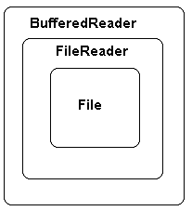
Text File Input via the Character Stream Classes
Reading characters from a File with a BufferedReader
A File wrapped with a FileReader wrapped with a BufferedReader | File file = new File ("myfile.txt"); FileReader fr =new FileReader(file); BufferedReader br = new BufferedReader(fr); int ch = br.read(); String s = br.readLine(); br.close();

Slide 49
Text File Input via the Character Stream Classes
Problem Statement:
Write a class, NumberLines that reads lines from a text file, numbers the lines sequentially, and writes the numbered lines to a second file.
The class should have two constructors:
NumberLines():
prompts for the names of the input and output files, and
NumberLines( String inputFile, String outputFile):
accepts the names of the input and output files.
Include a second class that demonstrates the NumberLines class.

Slide 50
Text File Input via the Character Stream Classes
Java Solution:
The NumberLines class:
import java.util.*;
import java.io.*;
public class NumberLines
{
private FileReader in;
private FileWriter out;
private BufferedReader br;
private BufferedWriter bw;
private PrintWriter pw;
private Scanner scanner = new Scanner(System.in);

Slide 51
Text File Input via the Character Stream Classes
public NumberLines() throws FileNotFoundException, IOException
{
String inputFile, outputFile;
System.out.print("Input File: ");
inputFile = scanner.next();
System.out.print("Output File: ");
outputFile = scanner.next();
in = new FileReader(inputFile); // throws FileNotFoundException
br = new BufferedReader(in); // wrap a BufferedReader around a FileReader
out = new FileWriter(outputFile); // throws an IO Exception
bw = new BufferedWriter(out);
pw = new PrintWriter(bw); // wrap a PrintWriter around a BufferedWriter
}

Slide 52
Text File Input via the Character Stream Classes
public NumberLines(String inputFile, String outputFile)
throws FileNotFoundException, IOException
{
in = new FileReader(inputFile); // throws FileNotFoundException
br = new BufferedReader(in); // wrap a BufferedReader around the FileReader
out = new FileWriter(outputFile); // Throws IOException
bw = new BufferedWriter(out);
pw = new PrintWriter(bw); // wrap a PrintWriter around a BufferedWriter
}

Slide 53
Text File Input via the Character Stream Classes
public void copy() throws IOException
{
String s;
int linecount = 0;
while ( (s = br.readLine() )!= null) // readLine() throws IOException
{
linecount++;
pw.println(linecount +". "+ s);
}
pw.close();
}
}

Slide 54
Text File Input via the Character Stream Classes
A test application TestNumberLines catches the exceptions that are thrown in NumberLines.
  import java.io.*;
  public class TestNumberLines
  {
  public static void main(String [] args)
  {
  try
  {
  NumberLines numberLines = new NumberLines();
  numberLines.copy();
  }
  catch (FileNotFoundException e)
  {
  System.out.println(e.getMessage());
  }
  catch (IOException e)
  {
  System.out.println(e.getMessage());
  }
  }
  }

Slide 55
Text File Input via the Character Stream Classes
Discussion:
lines 18-19, 26-27:
  A FileReader is connected to a BufferedReader.
  The FileReader constructor can throw a FileNotFoundException.
lines 20-22, 28-30:
  A FileWriter is wrapped in a BufferedWriter, which in turn is wrapped in a PrintWriter.
  The FileWriter constructor can throw an IOException.
line 36:
  The readLine() method can throw an IOException.
  The test application invokes the constructor NumberLines() and calls copy().
  Exceptions thrown in NumberLines are passed back to the caller.
  Because the caller catches these exceptions, no additional throws clause is necessary.

Slide 56
Text File Output via the Byte Stream Classes
To send output to a file:
  wrap a File with a FileOutputStream, a Byte Stream class,
  use the write() method of FileOutputStream, and
  close the stream.
The constructor FileOutputStream(File file) throws a FileNotFoundException.
The most useful methods of FileOutputStream are:
  void write(int b) throws IOException
  writes a single byte
  void close() throws IOException
  flushes and closes the stream, and
  void flush() throws IOException
  forces the data in the stream to be written to the appropriate file
This method is inherited from the class OutputStream.

Slide 57
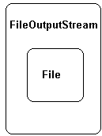
Text File Output via the Byte Stream Classes
FileOutputStream for writing bytes to a File
Wrap a File with FileOutputStream | File file = new File("myFile.txt"); FileOutputStream out = new FileOutputStream(file); or FileOutputStream out = new FileOutputStream("myFile.txt"); out.write(int b); out.close(); .

Slide 58
Text File Output via the Byte Stream Classes
The following fragment reads data from a text file, myinput.txt, and writes that data to another text file, myoutput.txt.
  int c;
  // get a File object
  File input = new File("myinput.txt");
  File output = new File("myoutput.txt");
  // connect to a stream
  FileInputStream in = new FileInputStream(input);
  // throws FileNotFoundException
  FileOutputStream out = new FileOutputStream(output);
  // throws FileNotFoundException
  while ( ( c = in.read()) != -1) //throws IOEXCEPTION
  out.write((char)c); // notice the cast to char;
  //throws IOEXCEPTION
  in.close(); //throws IOEXCEPTION
  out.close(); //throws IOEXCEPTION

Slide 59
Text File Output via the Byte Stream Classes
Text file output with the Byte Stream classes can be made more efficient by wrapping a BufferedOutputStream around a FileOutputStream:
  File output = new File (“myOutput.txt”);
  FileOutputStream out = new FileOutputStream(output);
  BufferedOutputStream brOutput = new BufferedOutputStream(out);

Slide 60
Text File Output via the Character Stream Classes
The FileWriter class provides several low level methods for writing character data to a file.
Because these methods do no buffering, they are rather inefficient.
These methods write just one character at a time.
Therefore, FileWriter methods usually work in conjunction with other classes.
FileWriter objects are instantiated using the constructors:
  FileWriter (File file); throws IOException;
  FileWriter(String filename); throws IOException;
The FileWriter methods include:
  void write(int ch) throws IOException;
  void write(String s) throws IOException;
  void close() throws IOException;
  void flush() throws IOException;

Slide 61
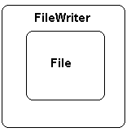
Text File Output via the Character Stream Classes
The FileWriter does File output, but very slowly
Wrap a File with a FileWriter | File file = new File ("myfile.txt"); FileWriter fw =new FileWriter(file) or FileWriter fw = new FileWriter("myfile.txt") char ch = 'a'; fw.write(ch); fw.flush(); fw.close()

Slide 62
Text File Output via the Character Stream Classes
The following segment instantiates and uses a FileWriter to print the alphabet to a file alphabet.txt.
  FileWriter fw = new FileWriter ("alphabet.txt");
  for (int i = 0 ; i < 26; i++)
  fw.write(i + 'a'); // i + ASCII('a')
  fw.close();
The segment writes one character at a time.
This is a very inefficient way to write information to a file.

